Slide 1



Miss . Lakshmi Soundarya Reddy Tetala
Mst . Eguram Sridhar Reddy
From :
Miss . Sakshi Jitendra Sapkale
Miss . Farheena Memon
From :

Slide 2
INDEX
S.NO | TOPIC | PAGE NO.
1 | TABLE GRAPH | 3 - 4
2 | ABSTRACT | 5
3 | CHAPTERS | 6-18
4 | CONCLUSION | 19

Slide 3
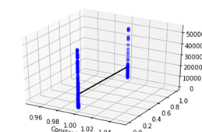
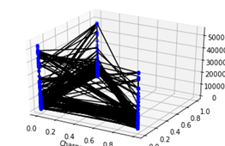
S.NO | GRAPH | TITLE | PAGE NO.
1. |  | MULTIPLE LINEAR REGRESSION | 7 - 9
2. |  | RANDOM FOREST | 10 - 12

Slide 4
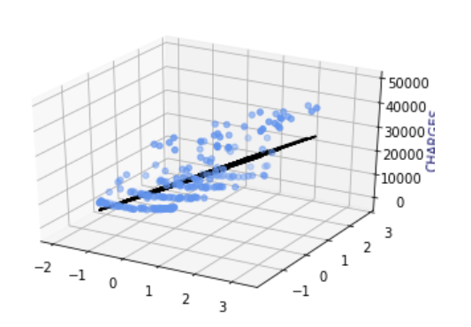
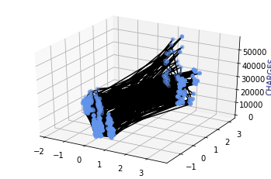
S.NO | GRAPH | TOPIC | PAGE NO.
3. |  | MULTIPLE LINEAR REGRESSION WITH PCA | 13 - 15
4. |  | RANDOM FOREST WITH PCA | 16 - 18

Slide 5
ABSTRACT
→ We need to achieve the best model among MLR model,RFR model,PCA with MLR model,PCA with RLR model for the given dataset.
→For this, we use different functions for their respective models.
→Ultimately, we find the best one among four models by finding the accuracy score of each model.

Slide 6
CHAPTER
SOFTWARE LIBRARIES USED IN ALL THE MODELS
PANDAS - Pandas is Python Data Analysis Library. In this project we have used it for reading and importing our Insurance dataset and also for data analysis..
Primary object types:
DataFrame: rows and columns (like a spreadsheet)
Series: a single column
NUMPY - (Numerical Python) is a linear algebra library in Python. It is a very important library on which almost every data science or machine learning Python packages such as SciPy (Scientific Python), Matplotlib (plotting library), Scikit-learn, etc depend.
MATPLOTLIB- This library is used for creating static, animated, and interactive visualizations.
SCIKIT LEARN - Scikit-learn is a free machine learning library for Python. It features various algorithms like support vector machine, random forests, and k-neighbours, and it also supports Python numerical and scientific libraries like NumPy and SciPy..

Slide 7
CHAPTER
3. MULTIPLE LINEAR REGRESSION
INTRODUCTION :

Slide 8
ALGORITHM

Slide 10
CHAPTER
3. RANDOM FOREST REGRESSION
INTRODUCTION :
Random Forest is a popular machine learning algorithm that belongs to the supervised learning. A Random Forest is an ensemble technique capable of performing both regression and classification tasks to improve the performance of the model. As in Decision Tree we had studied how just one decision tree works to give a particular output, but in this part we are going to study how the Random Forest Algorithm combines the output of multiple (randomly created) Decision Trees to generate the final and a better output.

Slide 11
ALGORITHM
Complete as fast as possible :)

Slide 13
CHAPTER
3. MULTIPLE LINEAR REGRESSION WITH PCA
INTRODUCTION :
PRINCIPAL COMPONENT ANALYSIS
Principal Component Analysis, or PCA, is a dimensionality-reduction method that is often used to reduce the dimensionality of large data sets, by transforming a large set of variables into a smaller
one that still contains most of the information in the large set.
MULTIPLE LINEAR REGRESSION
Multiple linear regression is used to explain the relationship between one continuous dependent variable and two or more independent variables. The independent variables can be continuous or categorical (dummy coded as appropriate).

Slide 14
ALGORITHM
●Imported libraries (Pandas as pd, Matplotlib.pyplot as mtp , Numpy as np)
●Imported dataset into data.
●Did Exploratory Data Analysis to know more about the dataset. The dataset has 1338 rows and 7 columns. There are 3 categorical columns and no null values in the dataset.
●As PCA is designed for continuous data , categorical columns were ignored and others were stored in data. So, data has 1338 rows and 4 columns.
●Removed outliers to make the results more significant. This was done using z_score. For this stats module was imported from Scipy library.
●After removing the outliers the dataset has 1309 rows and 4 columns.
●Extracted the data into x and y.
●Did feature scaling to normalize the data. Standard Scaler from the module preprocessing of the Scikit learn library was used.
●After this PCA was performed. This was done using PCA which was imported from the decomposition module of the Scikit learn library. Chose components as 2 because it can explain 76% of the data. The dimensions were reduced to 2.
● The dataset was spit into training and test sets (x_tr,x_te,y_tr,y_te) using the function train_test_split from the module selection of the Scikit learn library.

Slide 15
●Linear Regression was imported from the module linear_module of the Scikit learn library. The model was trained with passing in x_tr, y_tr.
●The values are predicted using the predict function by passing in x_te values and these values were stored in y_pred.
●To plot a 3D graph mplot3D is imported from mpl_toolkits. A 3Dscatterplot was plotted between the 1st column of x_te, the 2nd column of x_te and y_te. A 3Dplot was plotted between the 1st column of x_te, 2nd column of x_te and y_pred.
●The RMSE,MAE, MSE and r2_score were imported from the module metrics of the Scikit learn library.
These are the scores –
MAE : 5555.998306482995
MSE : 48500318.33509166
RMSE : 6964.21699368218
r2 score : 0.6890072523530008

Slide 16
CHAPTER
3. RANDOM FOREST REGRESSION WITH PCA
INTRODUCTION :
Principal Component Analysis or PCA is a widely used technique for dimensionality reduction of the large data set. Reducing the number of components or features costs some accuracy and on the other hand, it makes the large data set simpler, easy to explore and visualize. Also, it reduces the computational complexity of the model which makes machine learning algorithms run faster.
Random forests or random decision forests are an ensemble learning method for classification, regression and other tasks that operate by constructing a multitude of decision trees at training time and outputting the class that is the mode of the classes (classification) or mean prediction (regression) of the individual …

Slide 17
ALGORITHM
●Imported libraries (Pandas as pd, Matplotlib.pyplot as mtp , Numpy as np)
●Imported dataset into data.
●Did Exploratory Data Analysis to know more about the dataset. The dataset has 1338 rows and 7 columns. There are 3 categorical columns and no null values in the dataset.
●To get rid of categorical data and converting to Machine understable language, I used the Encoding part to encode the Categorical columns and Ultimately we get the dataset in Machine Readable form(Binary format)
●Extracted the data into x and y.
●Did feature scaling to normalize the data. Standard Scaler from the module preprocessing of the Scikit learn library was used.
●After this PCA was performed. This was done using PCA which was imported from the decomposition module of the Scikit learn library. Chose components as 2.. The dimensions were reduced to 2 as per the better predictions for this model..
● The dataset was split into training and test sets (x_tr,x_te,y_tr,y_te) using the function train_test_split from the module selection of the Scikit learn library.
● We consider the Training set data to train on Random Forest Regressor model. The RandomForestRegressor Function has an argument called n_estimators.
● We consider n_estimators=2000(which means 2000 Decision tree models) for better accuracy as for this Model.
● Ultimately,we predict the Test set results and checking the accuracy of the model.

Slide 18
●RandomForestRegression was imported from the module ‘ensemble’ of the Scikit learn library. The model was trained with passing in x_tr, y_tr.
●The values are predicted using the predict function by passing in x_te values and these values were stored in y_pred.
●To plot a 3D graph mplot3D is imported from mpl_toolkits. A 3Dscatterplot was plotted between the 1st column of x_te, the 2nd column of x_te and y_te. A 3Dplot was plotted between the 1st column of x_te, 2nd column of x_te and y_pred.
●The RMSE,MAE, MSE and r2_score were imported from the module metrics of the Scikit learn library.
These are the scores –
Mean Absolute Error: 4191.676979121483
Mean Squared error: 36425789.40829998
Root Mean Squared Error: 6035.378149569419
R^2 score: 0.7646984037003144

Slide 19
CONCLUSION :
Random Forest is suitable for situations when we have a large dataset, and interpretability is not a major concern.

